Slide 1
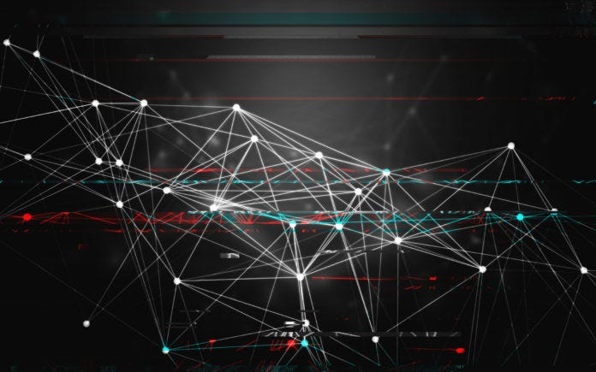
Neural Network

Slide 2
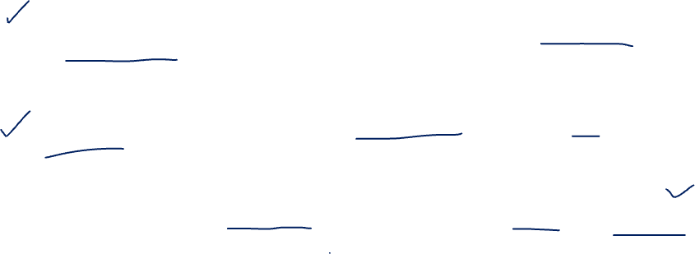
How does tokenization work in ChatGPT ?
GPT-3 uses a technique called Byte Pair Encoding (BPE) for its word embeddings. BPE is a type of subword tokenization method that starts with a vocabulary of single characters and iteratively merges the most common pair of consecutive characters or character sequences.
This approach allows the model to handle a wide range of words, including rare and out-of-vocabulary words, by breaking them down into smaller subword units.
Once the words are tokenized, each token is associated with a high-dimensional vector that is learned during the training process. These vectors capture semantic and syntactic information about the words.

Slide 3
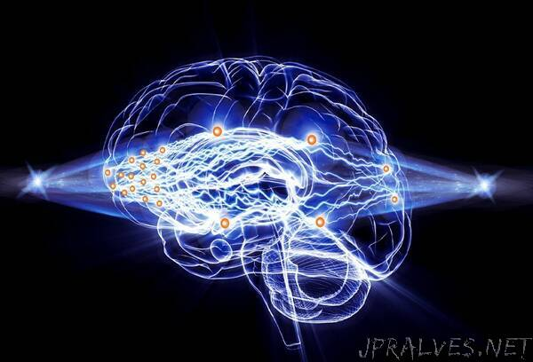
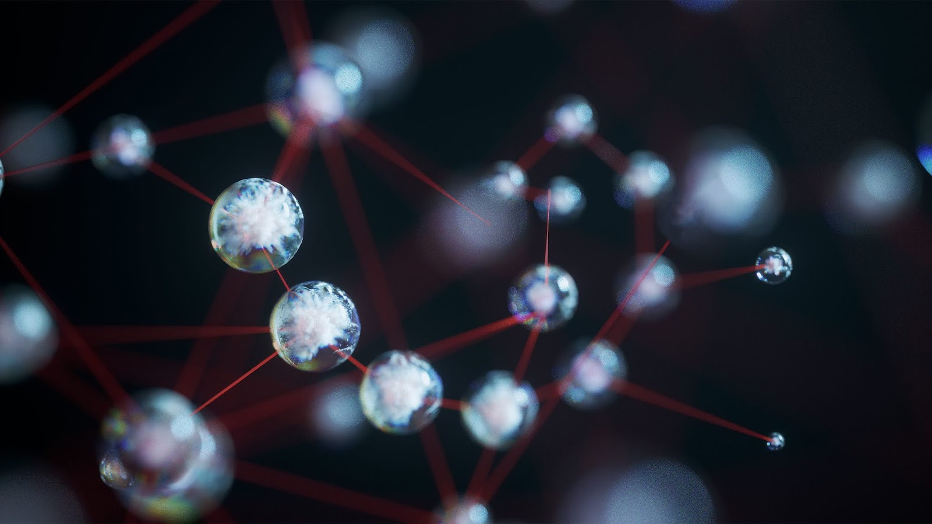
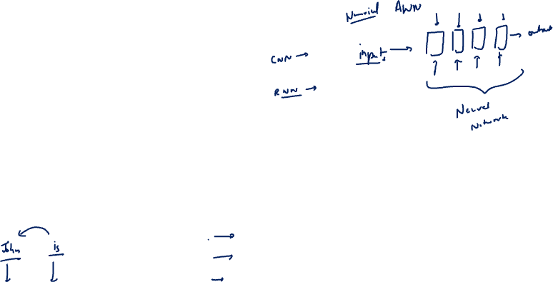
Models to handle text
(sequential data)

Slide 4
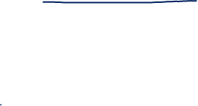
RNN – recurring neural network
To control the sequence of text or handling time series data RNN is used.
RNNs are a type of neural network that can be used to model sequence data.
RNNs, which are formed from feedforward networks, are similar to human brains in their behaviour.
Simply said, recurrent neural networks can anticipate sequential data in a way that other algorithms can’t.
The most important component of RNN is the Hidden state, which remembers specific information about a sequence.

Slide 5
Graphical Representation of RNN
Y1 pred
f
Ot
O2
O4
O1
O3
f
Y1 pred
w
w
w
w
x1
x11
x12
x13
x14
X1 = [x11 + x12 + x13+ x14] Y1

Slide 6
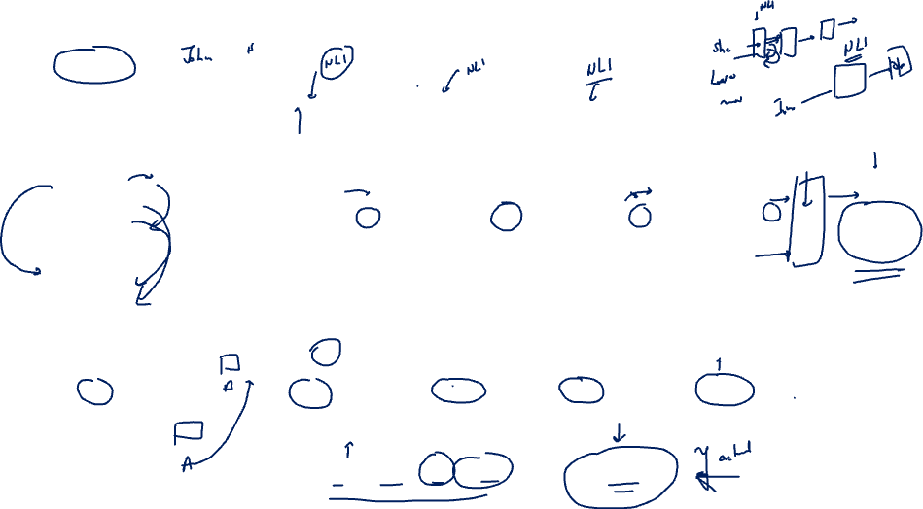
Y1 pred
nn
Ot
O2
O4
O1
O3
f
Y1 pred
w
w
w
w
x1
She
Loved
the
movie
X1 = [she loved the movie] “positive”

Slide 7
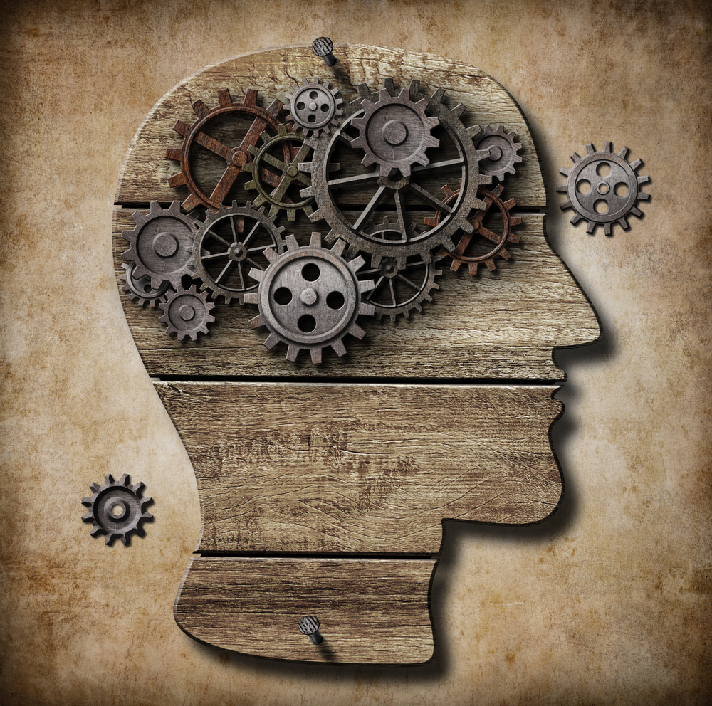
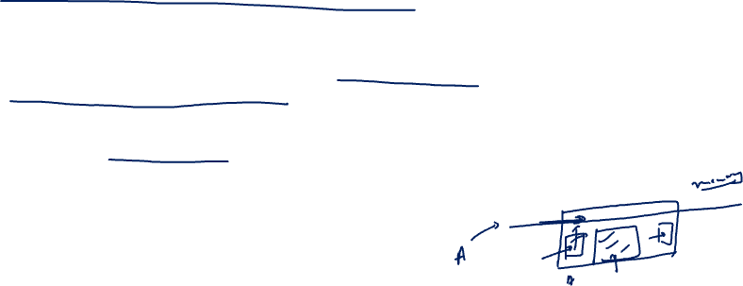
Long Short Term Memory
LSTMs are a type of recurrent neural network (RNN) that have a specific structure designed to capture long-term dependencies in sequential data.
LSTMs use memory cells and gates to selectively store and retrieve information over multiple time steps, allowing them to capture long-range dependencies.

Slide 8

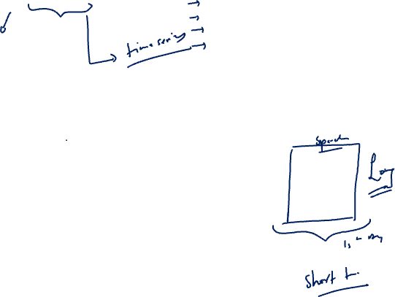
Why it is called LSTM ?
Short-Term: The "short-term" part refers to the idea that LSTM networks are designed to remember information for short periods of time.
Long: The "long" part refers to the LSTM's ability to remember or "memorize" longer sequence of information.

Slide 9

What makes LSTM better than RNN?
LSTM incorporates gates, such as input, forget, and output gates, which allow it to selectively remember or forget information over long sequences, enabling the capture of long-term dependencies.
Unlike simple RNNs, LSTM has a separate memory cell that can maintain information over long periods.
LSTM's gating mechanism enables it to handle variable-length sequences and learn to focus on relevant inputs, enhancing its ability to capture important information and ignore noise.

Slide 10
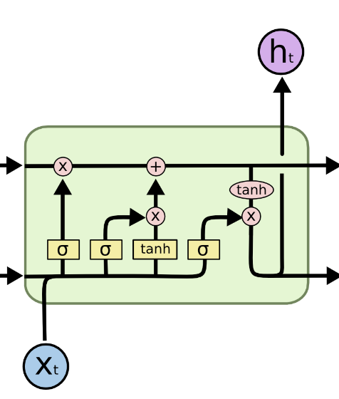
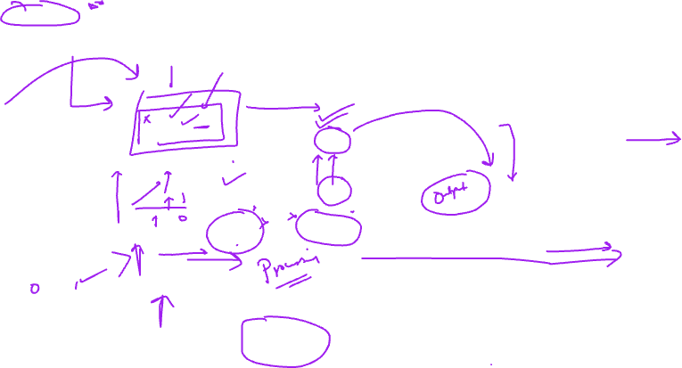
Memory Gate
Forget gate
Output Gate
Input Gate

Slide 11
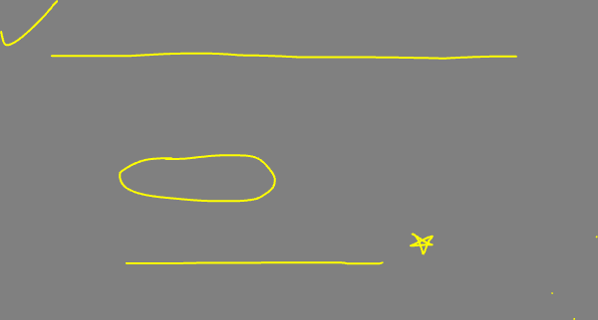
Gated Recurrent Units (GRUs)
GRUs are a variation on LSTMs that use a gating mechanism to control the flow of information but with fewer parameters than LSTM as they lack an output gate.
They have similar performance characteristics to LSTMs but are computationally more efficient.

Slide 12

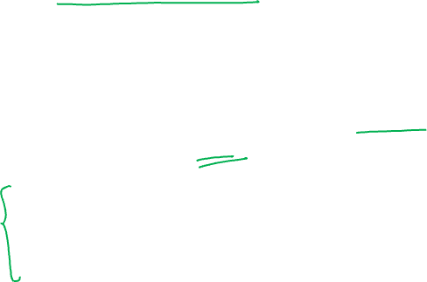
Transformers
The transformer architecture introduced in the original "Attention is All You Need" paper by Vaswani et al. forms the basis of GPT.
It utilizes self-attention mechanisms to capture dependencies between different words or tokens in a sequence, enabling the model to consider the context effectively.

Slide 13
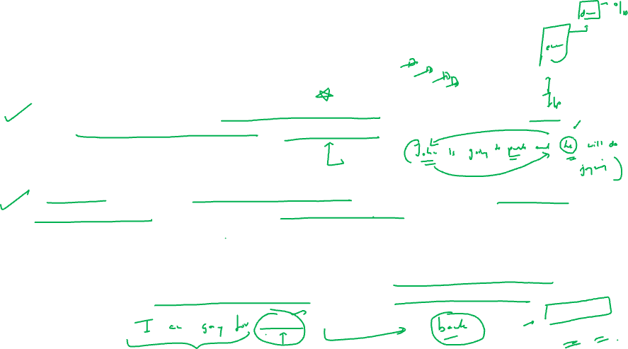
The transformer architecture consists of two main components
The encoder (librarian) reads a sentence (book) all at once, understanding each word's (page's) context through self-attention (cross-referencing). This process, repeated in layers, refines the sentence understanding.
The decoder (storyteller) generates a new sentence (story) word by word, considering previous words (story so far) and the encoder's understanding (original book). This is done through self-attention, ensuring each new word fits the context.
The Transformer model's innovation is its ability to process all words simultaneously, enabling it to understand complex word relationships, crucial for tasks like translation.

Slide 14
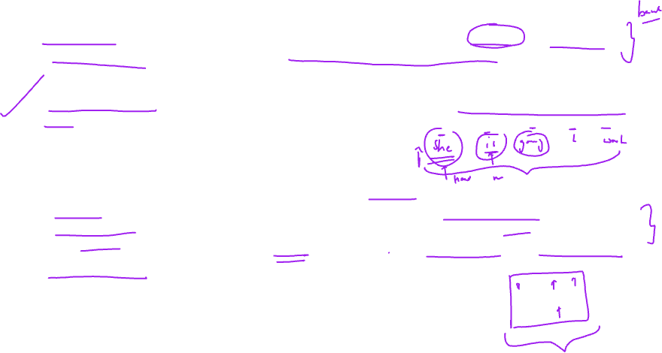
Self-attention, in very simple terms, is a mechanism that allows a word to look at other words in the sentence to get better context for understanding its meaning.
Multihead attention: It allows the model to pay attention to different things at the same time. Each 'head' in the multi-head attention is like a separate attention mechanism that focuses on a different aspect of the input data.
So, instead of just looking at the words in the sentence once, the model looks at them multiple times (once for each head), each time focusing on different features or relationships between the words. This allows the model to capture a richer understanding of the data, as each head can potentially learn to focus on different types of relationships.

Slide 15
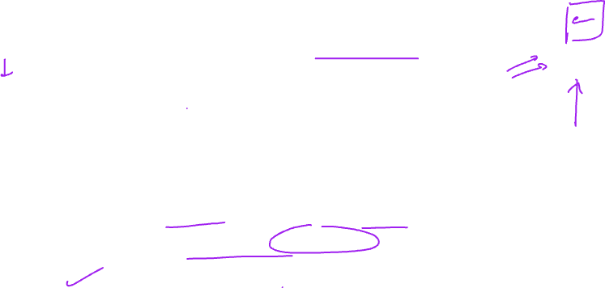
How does transformer model understand order of the words?
Positional encoding is used in the Transformer model because it doesn't inherently understand the order or position of words in a sentence.
Positional encoding adds information about the position of each word, helping the model understand word order and the meaning of sentences better.

Slide 16
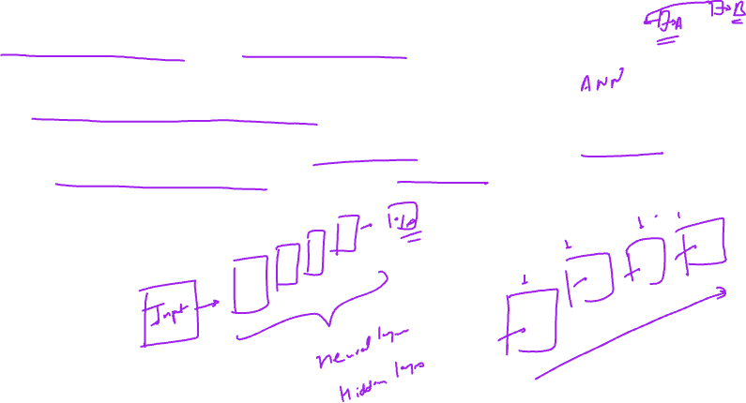
Feed Forward Neural Network
Feed-forward neural networks are a type of artificial neural network where information moves in one direction: from the input layer, through any hidden layers, to the output layer. There are no cycles or loops in the network, meaning the output of any layer does not affect that same layer.

Slide 17
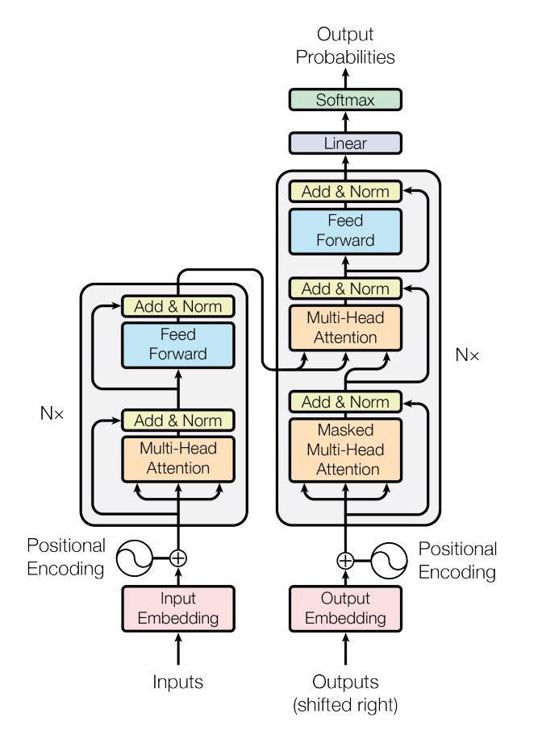
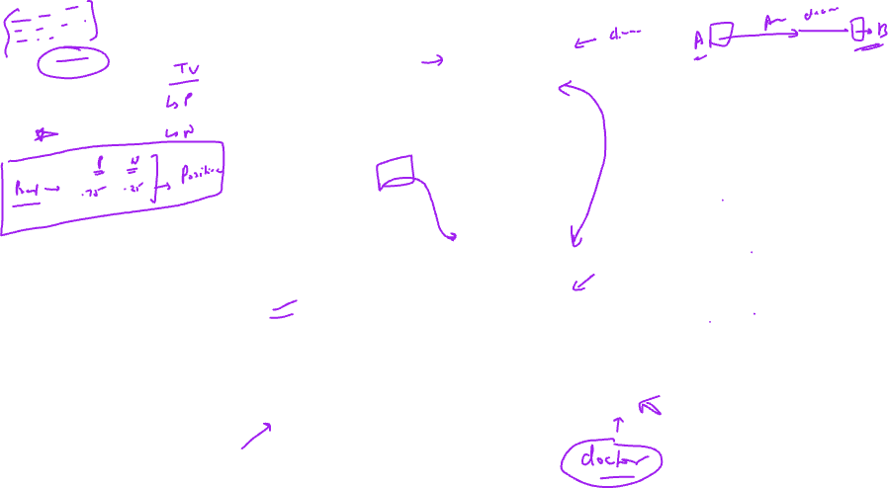
Y predicted
Y predicted
Multihead attention
+
Feed Forward
Multihead attention
+
Feed Forward
DECODER
Masked Y actual
ENCODER
Y actual

Slide 18
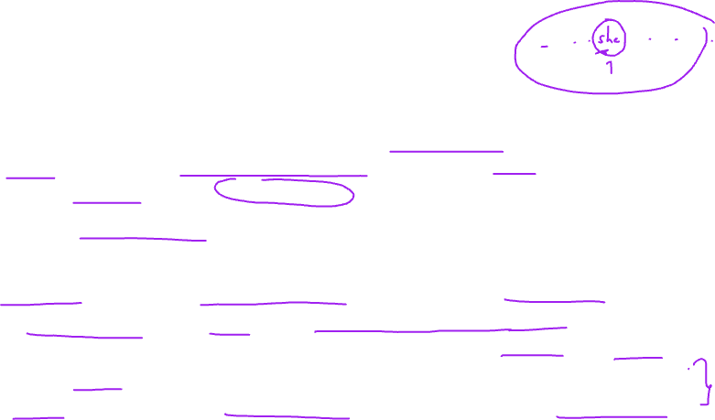
The transformer architecture allows for efficient training and inference due to its parallelizable nature. It avoids sequential computations by using self-attention, which enables the model to capture global dependencies in the input sequence.
ChatGPT extends the GPT architecture with additional modifications and fine-tuning specifically for conversational dialogue tasks. While the exact architecture and modifications used in ChatGPT are not publicly disclosed, it is built upon the same fundamental principles of self-attention and transformer architecture as the original GPT model.

Slide 19
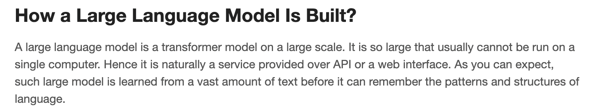

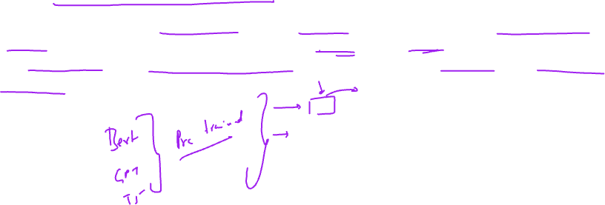

Slide 20
